Slide 1


INFORMATION SESSION
2021
Discretionary Grantmaking
Notes:
Phil

Slide 2

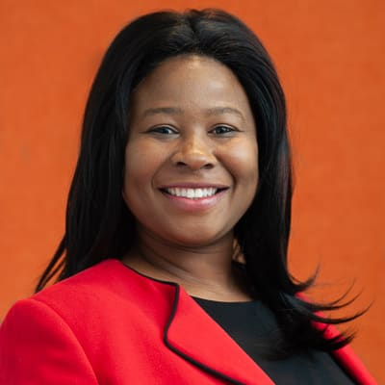
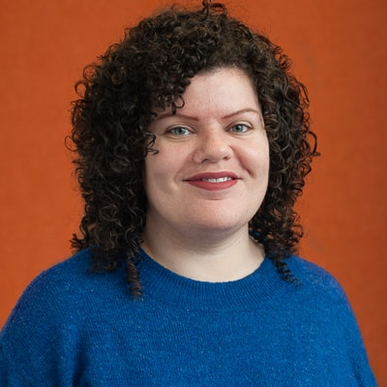
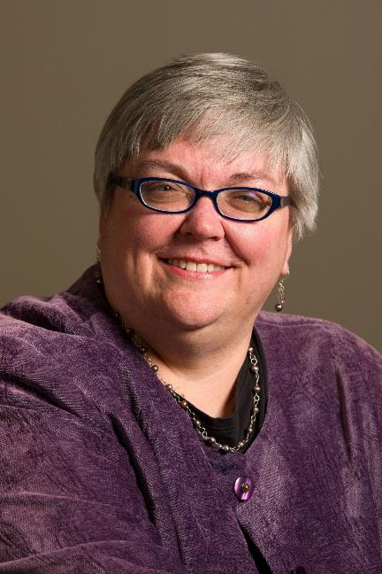
      PHILADELPHIA FOUNDATION KEY STAFF CONTACTS:
      PHIL FITZGERALD
      Executive Director of Grantmaking
      Special Initiatives
      Discretionary Grantmaking
      SHERESSA GORDON
      Program Officer Associate
      Donor Advised Funds
      Special Initiatives
      EDURNE (EDDIE) IRIZARRY
      Senior Program Officer
      Discretionary Grantmaking
      YOUTHadelphia
      LEANN AYERS
      Brook J. Lenfest Foundation Grants
      Scholarships
04
Notes:
Phil

Slide 3
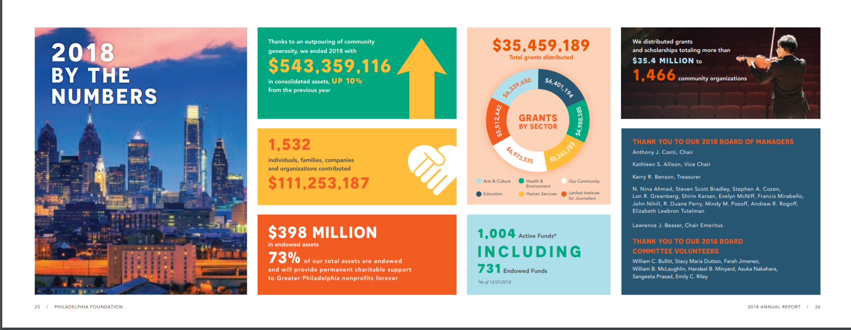
Philadelphia Foundation
Community Foundation – Charitable dollars are made up of donations from individuals, families, businesses and sometimes government grants.
Notes:
Phil

Slide 4
Philadelphia Foundation – Grantmaking breakdown
Donor Advised Funds (DAFs) - a process administered by the Philadelphia Foundation to manage charitable donations on behalf of organizations, families, or individuals.
Discretionary Grantmaking – a process where Philadelphia Foundation staff exercise judgment (discretion) in selecting the grant recipient organization through a competitive process.
Notes:
Phil
Chart of dollars spent for each heading

Slide 5
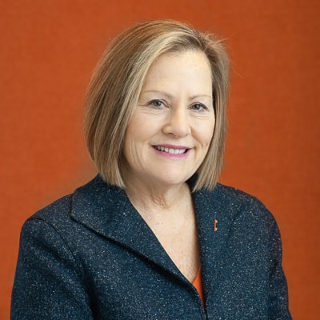
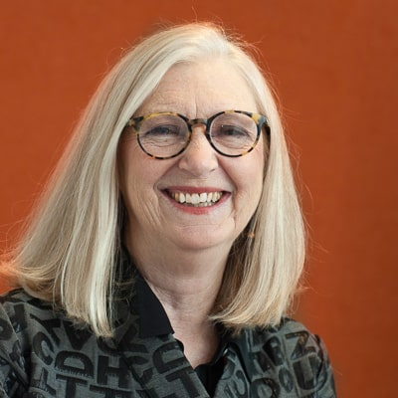
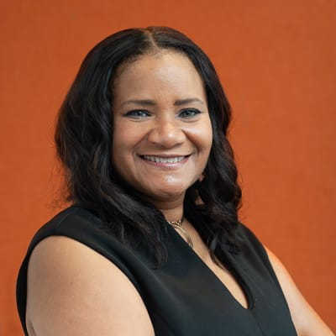
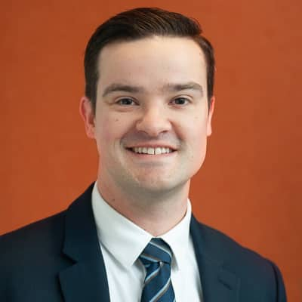
Philadelphia Foundation – DAF Team from left to right.
LOIS GABIN-LEGATO
Vice President of Institutional Advancement and Chief Advancement Officer
MAGGI KIRK
Development and Donor Services Officer
MARSHA BUDD
Donor Services Officer
CHRISTOPHER BYERS
Development Officer, Gifts and Operations
Blank Template
Notes:
Phil

Slide 6
Discretionary Grantmaking Highlights
      Discretionary Grantmaking prioritizes low-income communities and organizations led and serving Black/Brown & Indigenous People of Color (BIPOC)
      Grants serve Greater Philadelphia and Southern New Jersey
      Emphasis on general operating support and capacity building
      Applications are accepted on a rolling basis. To be considered for a grant in:
  April 2021, applications should be received by February 12
  June 2021, applications should be received by April 16
  November 2021, applications should be received by September 10
04
Notes:
Eddie

Slide 7

Discretionary Grantmaking Categories
Leadership Grants
Project grants available on a competitive basis to increase measurable skills and racial diversity of pipelines for senior staff and board of nonprofits; and to strengthen organizational capacity and nonprofit leaders in the areas of governance, planning, civic engagement, board and staff development and diversity, equity and inclusion.
Direct Service Grants
Unrestricted grants available on a competitive basis for well-run, direct-service nonprofits serving communities with high poverty rates. Priority will be given to organizations serving communities disproportionately impacted by COVID-19.
Impact Program Grants
Program grants available to nonprofits demonstrating programmatic impact.
04
Notes:
Phil
Include a link to each application

Slide 8
Discretionary Grantmaking Categories
Advocacy Unrestricted Grants
Unrestricted grants available to organizations addressing policy changes in relation to racial and social justice. Emphasis on utilizing advocacy and community organizing best practices towards policy change on behalf of marginalized and low-income communities in Greater Philadelphia.
Fund for Children Strategic Investment in Youth Grants
Unrestricted grants for Philadelphia-based youth organizations whose missions prioritize youth leadership, civic engagement and youth organizing activities and outcomes. Emphasis on organizations whose model is in line with the Youth Engagement Continuum leadership, civic engagement and organizing columns.
YOUTHadelphia Grants
Program/Project grants to youth organizations whose programs/projects include social and political themes and content; and help young people build skills/capacities to be decision makers and action-oriented problem solvers. Emphasis on youth-led programs/projects.
YOUTHadelphia APPLICATION due by 5:00 pm on Friday, February 26. Register for Jan. 28 OH: HERE
04
Notes:
Eddie
Include a link to each application

Slide 9
Basic Eligibility
Direct Service; Impact Program; Advocacy; Leadership –
Must be a 501 (c) (3) or Fiscally Sponsored by a 501 © (3).
Must serve Greater Philadelphia.
At least 70% of those served can be categorized as low-income.
At least 70% of those served are considered marginalized or historically disenfranchised.
Statewide or national organizations with a local presence - Local office must raise at least 75% of its operating budget and have a local Advisory Board.
Fund for Children & YOUTHadelphia –
At least 90% to 100% of those served by the organization can be categorized as children (1 to 12) and youth (13 to 18)
All staff and volunteer child abuse clearances are up to date including PA Child abuse, criminal history, and FBI fingerprinting.
Statewide or national organizations with a local presence - Local office must raise at least 80% of its operating budget and have a local Advisory Board.
04

Slide 10
Important Considerations
Direct Service; Impact Program; Advocacy; Leadership; Fund for Children –
Priority funding to organizations led by BIPOC chief executives or board chairs
Organizations must support BIPOC and other historically marginalized and under-invested communities
Cannot have deficits greater than 10% of operating budget in the past year.
Organizations with Interim ED’s must show Board approved hiring and on-boarding plan for permanent Executive Director.
Organizations operating less than 3 years must provide executive summary of Board approved strategic plan or organization logic model.
Statewide organizations will differentiate work done in Philadelphia and surrounding counties from its broader statewide programming. Grants to these organizations will be pro-rated based upon their work in Greater Philadelphia.
Generally, the Philadelphia Foundation does not use discretionary dollars to support organizations where there are familial relationships across the board and staff.
Have the following policies in place, as indicated in the Part VI, Section B of the Form 990.
  Conflict of Interest Policies
  Whistleblower Policy
  Independent process with comparability data for determining compensation
  Providing copy of the 990 to board members prior to filing
Organizations cannot apply for both the FFC and PF’s other Discretionary Grantmaking programs -- within the same calendar year.
04
Notes:
Eddie

Slide 11
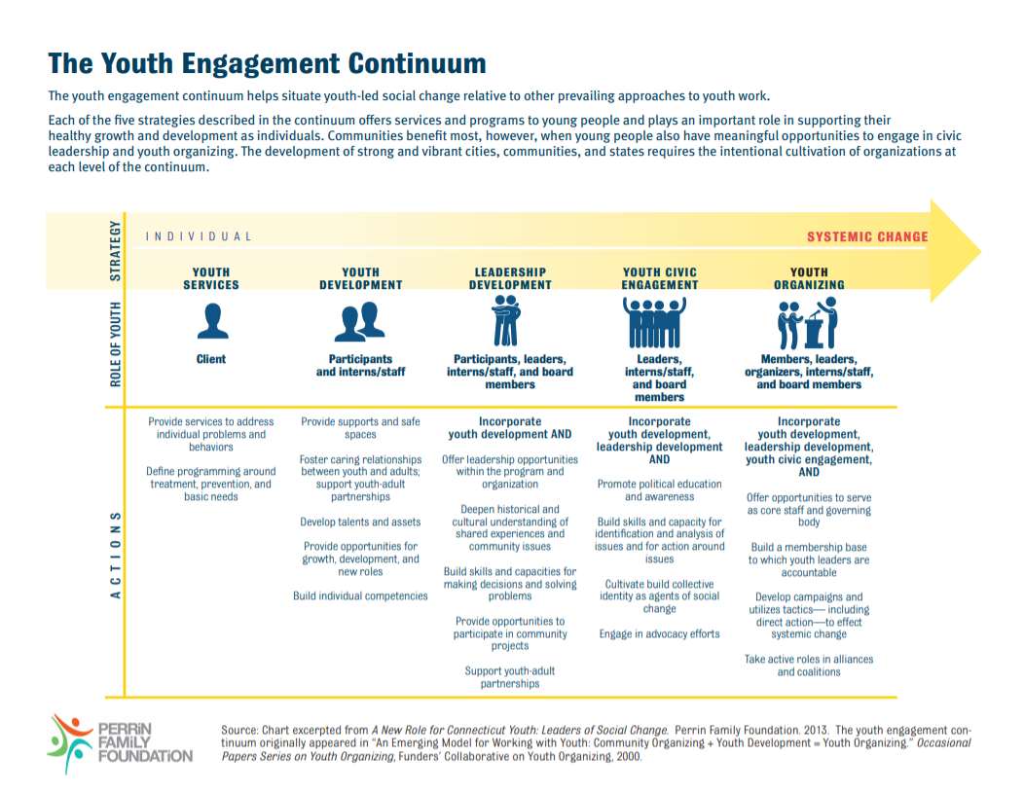
Important Considerations
Fund for Children –
General support not programmatic.
Organization model is in line with the Youth Engagement Continuum, specifically leadership, civic engagement and organizing columns.
YOUTHadelphia –
Emphasis on youth-led programs/projects.
Application is written or video submission
Info session on Thursday, January 28, 5:00 pm. Via Zoom. Register for Jan. 28 OH: HERE
04
Notes:
Eddie

Slide 12
Application Process
Nonprofits that meet basic eligibility requirements are required to complete the application and upload all supplemental documents:
501(c)(3) IRS determination letter
List of Board of Directors
Most recent Audit (if your organization does not have audits, we will accept your IRS 990 or Profit Loss Statement)
Current PA Bureau of Charitable Organizations Certificate
Executive Summary of current strategic plan
Board-approved Nondiscrimination Policy
Organizational Budget
If Applicable:
Organizations with Interim ED’s - Board approved hiring and on-boarding plan for permanent Executive Director.
Organizations operating less than 3 years – Logic Model
04
Notes:
Operate in at least one of the following counties: Bucks, Chester, Delaware, Montgomery, and Philadelphia in PA or Burlington and Camden in NJ
PRIORITY FOR APPLICATIONS THAT CAN DEMONSTRATE:
Strong community partnerships
Existing collaborations among several nonprofits and/or government/corporate partners
Opportunities to leverage other investments
Has a plan for sustainability over the long term
HOW TO APPLY:
ALL APPLICATIONS MUST BE SUBMITTED ONLINE
Visit www.philafound.org/keygrants to apply

Slide 13
Application Deadlines
    Applications are accepted on a rolling basis. To be considered for a grant in:
April 2021, applications should be received by February 12
June 2021, applications should be received by April 16
November 2021, applications should be received by September 10
04
Notes:
UPDate

Slide 14
Other Available Grants, Special Initiatives & Scholarships
The Henrietta Tower Wurts Memorial -
A charitable foundation formed to carry out the wishes of Henrietta Tower Wurts, who passed away in 1933. Supports nonprofits serving children and youth and/or the elderly in the City of Philadelphia. WEBPAGE
The Edna W. Andrade Fund
A Donor Advised Fund of the Philadelphia Foundation, supports grants for local or national museums or nonprofit art organizations to benefit visual fine artists from Greater Philadelphia. WEBPAGE
Forman Family Fund
Supports Greater Philadelphia nonprofits serving young people aged 11 to 18 offering in-school or out-of-school-time programs that address one of the following areas: Photography, Architectural Drawing and Architecture, Written Arts. WEBPAGE
GSK IMPACT Awards for Greater Philadelphia
Annually honors up to ten local nonprofit organizations with $40,000 each in recognition of their exceptional achievements, overall excellence and best practices in contributing to a healthier Greater Philadelphia Region. WEBPAGE
04
Notes:
Sheressa

Slide 15
Other Available Grants, Special Initiatives & Scholarships
Brook J. Lenfest Foundation Grants
A charitable foundation established by Brook J. Lenfest in 2000. For programs operating in the Greater Philadelphia region, with an emphasis on Philadelphia. Priority funding to education and job training programs that successfully prepare participants to earn at least a lower middle-class, family sustaining income over the course of their working lifetimes. WEBPAGE
Scholarships
Funds established by generous individuals, families, businesses and organizations to ensure that local students can pursue their educational dreams. WEBPAGE
04
Notes:
LeAnn

Slide 16
Key Skills Hub
The Key Skills Hub is a marketplace for volunteerism where the community and the corporate sector of Philadelphia meet to work towards improving the quality of life of our neighborhoods, our city and beyond.
Greater Philadelphia nonprofits can sign up for free support from a broad range of skills-based volunteer professionals. Key Skills Hub Webpage
Notes:
Phil

Slide 17
Q&A
04

Slide 18
THANK YOU!
      FOR MORE INFORMATION AND TO APPLY:
      Visit https://www.philafound.org/nonprofits/
    QUESTIONS:
      Submit any additional inquiries to grantmakingservices@philafound.org
04

